Slide 1
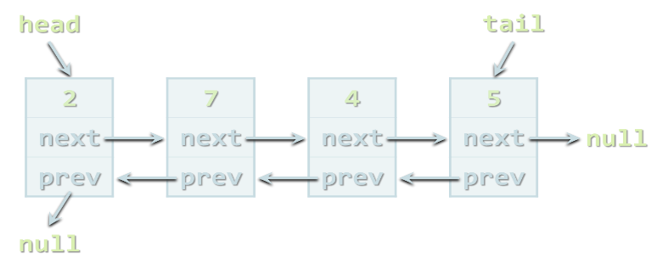



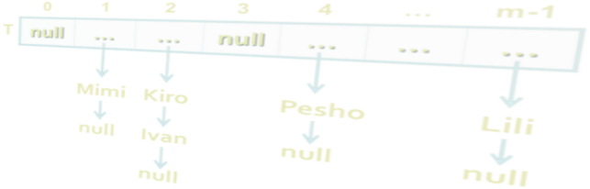
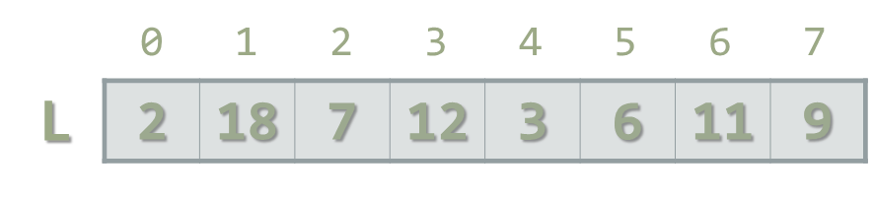

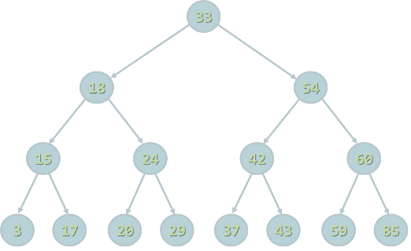
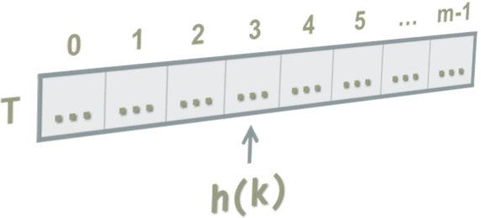
Java Collections
Arrays, Lists, Strings, Sets, Maps
SoftUni Team
Java
Technical Trainers
Software University
http://softuni.bg

Slide 2


Table of Contents
Arrays
int[], String[] …
Lists
ArrayList<E> examples
Sets
HashSet<E>, TreeSet<E>
Maps
LinkedHashMap<K, V>, TreeMap<K, V>
Recursion
Traversing the File System

Slide 3


Warning: Not for Absolute Beginners
The "Java Fundamentals" course is NOT for absolute beginners
Take the "C# Basics" course at SoftUni first: https://softuni.bg/courses/csharp-basics
The course is for beginners, but with previous coding skills
Requirements
Coding skills – entry level
Computer English – entry level
Logical thinking
coding skills
required!

Slide 4

Arrays

Slide 5
What are Arrays?
In programming array is a sequence of elements
All elements are of the same type
The order of the elements is fixed
Has fixed size (length)
0 1 2 3 4
Element index
Array of 5 elements
… | … | … | … | …
Element of an array

Slide 6
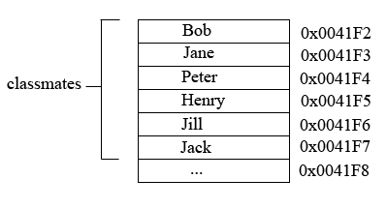
How arrays are stored in the memory
Reference data type
Variable “classmates” holds addresses in the heap as values.
Each address points to a separate value in the heap memory.

Slide 7
Working with Arrays in Java
Allocating an array of 10 integers:
Assigning values to the array elements:
Accessing array elements by index:
int[] numbers = new int[10];
for (int i=0; i<numbers.length; i++)
numbers[i] = i+1;
numbers[3] = 20;
numbers[5] = numbers[2] + numbers[7];

Slide 8
Arrays of Strings
You may define an array of any type, e.g. String:
String[] names = { "Peter", "Maria", "Katya", "Todor" };
for (int i = 0; i<names.length; i++) {
System.out.printf("names[%d] = %s\n", i, names[i]);
}
for (String name : names) {
System.out.println(name);
}
names[4] = "Nakov"; // ArrayIndexOutOfBoundsException
names.length = 5; // array.length is read-only field

Slide 9
Read, Sort and Print Array of n Strings
Scanner scanner = new Scanner(System.in);
int n = scanner.nextInt();
scanner.nextLine();
String[] lines = new String[n];
for (int i = 0; i < n; i++) {
lines[i] = scanner.nextLine();
}
Arrays.sort(lines);
for (int i = 0; i < lines.length; i++) {
System.out.println(lines[i]);
}

Slide 10

Arrays
Live Demo

Slide 11
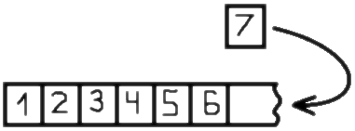
Lists
Using ArrayList<E>

Slide 12
Lists in Java
In Java arrays have fixed length
Cannot add / remove / insert elements
Lists are like resizable arrays
Allow add / remove / insert of elements
Lists in Java are defined through the ArrayList<E> class
Where E is the type of the list, e.g. String or Integer
ArrayList<Integer> numbers = new ArrayList<Integer>();
numbers.add(5);
System.out.println(numbers.get(0)); // 5

Slide 13
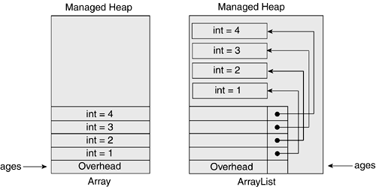
How array lists are stored in the memory
Reference data type
Variable “ages” holds pointers to Objects in the heap as values.
Each Object has an address that points to a value in the memory.
Future reference
Arrays vs ArrayLists

Slide 14
ArrayList<String> – Example
ArrayList<String> names = new ArrayList<String>() {{
add("Peter");
add("Maria");
add("Katya");
add("Todor");
}};
names.add("Nakov"); // Peter, Maria, Katya, Todor, Nakov
names.remove(0); // Maria, Katya, Todor, Nakov
names.remove(1); // Maria, Todor, Nakov
names.remove("Todor"); // Maria, Nakov
names.addAll(Arrays.asList("Alice", "Tedy"));
// Maria, Nakov, Alice, Tedy
names.add(3, "Sylvia"); // Maria, Nakov, Alice, Sylvia, Tedy
names.set(2, "Mike"); // Maria, Nakov, Mike, Sylvia, Tedy
System.out.println(names);

Slide 15
ArrayList<Integer> – Example
// This will not compile!
ArrayList<int> intArr = new ArrayList<int>();
ArrayList<Integer> nums = new ArrayList<>(
Arrays.asList(5, -3, 10, 25));
nums.add(55); // 5, -3, 10, 25, 55
System.out.println(nums.get(0)); // 5
System.out.println(nums); // [5, -3, 10, 25, 55]
nums.remove(2); // 5, -3, 25, 55
nums.set(0, 101); // 101, -3, 25, 55
System.out.println(nums); // [101, -3, 25, 55]

Slide 16


ArrayList<E>
Live Demo

Slide 17
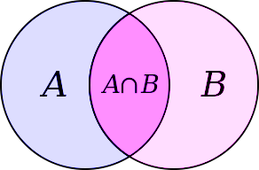
Sets
HashSet<E> and TreeSet<E>

Slide 18
Sets in Java
Sets in Java keep unique elements
Like lists but duplicated elements are stored only once
HashSet<E>
Keeps a set of elements in a hash-tables
The elements are randomly ordered (by their hash code)
TreeSet<E>
Keeps a set of elements in a red-black ordered search tree
The elements are ordered incrementally

Slide 19
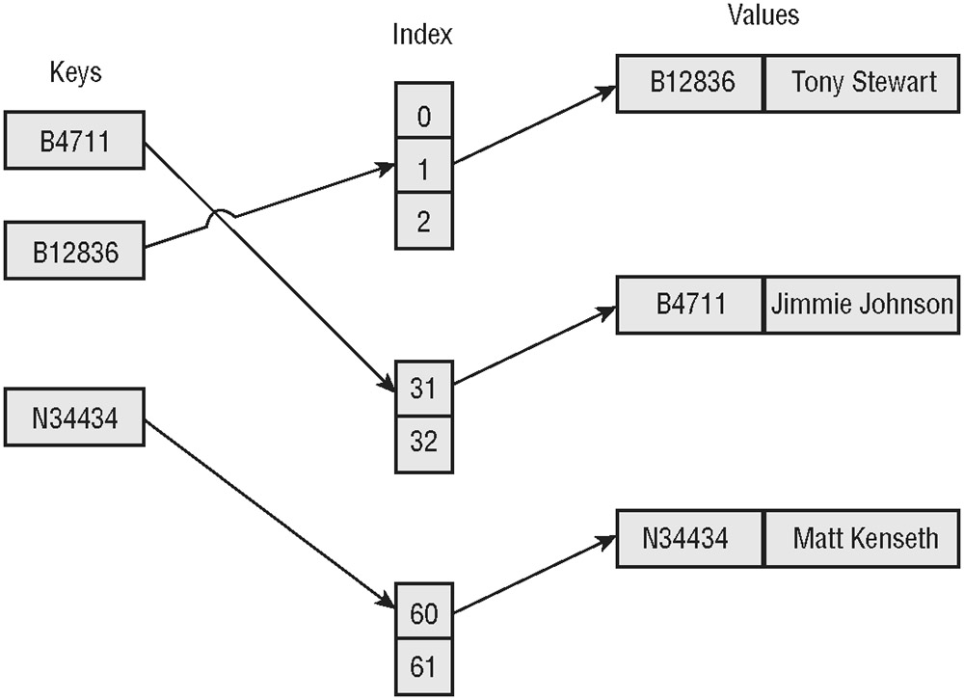
How hash sets are stored in the memory
Reference data type
Variable “names” holds hash indexes that point to Objects in the heap as values.
Each Object has an address that points to a value in the memory.
Future Reference
HashSet
TreeSet

Slide 20
HashSet<E> and TreeSet<E> – Examples
Set<String> set = new TreeSet<String>();
set.add("Pesho");
set.add("Tosho");
set.add("Pesho");
set.add("Gosho");
set.add("Maria");
set.add("Alice");
set.remove("Pesho");
System.out.println(set); // [Alice, Gosho, Maria, Tosho]

Slide 21
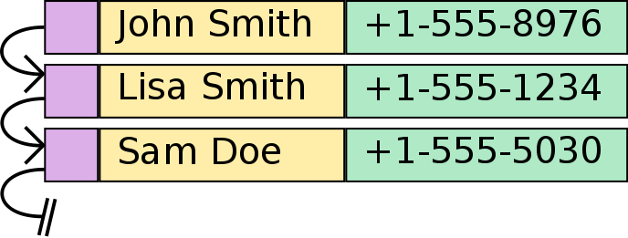
Maps

Slide 22
Maps in Java
Maps in Java keep unique <key, value> pairs
HashMap<K, V>
Keeps a map of elements in a hash-table
The elements are randomly ordered (by their hash code)
TreeMap<K, V>
Keeps a set of elements in a red-black ordered search tree
The elements are ordered incrementally by their key

Slide 23
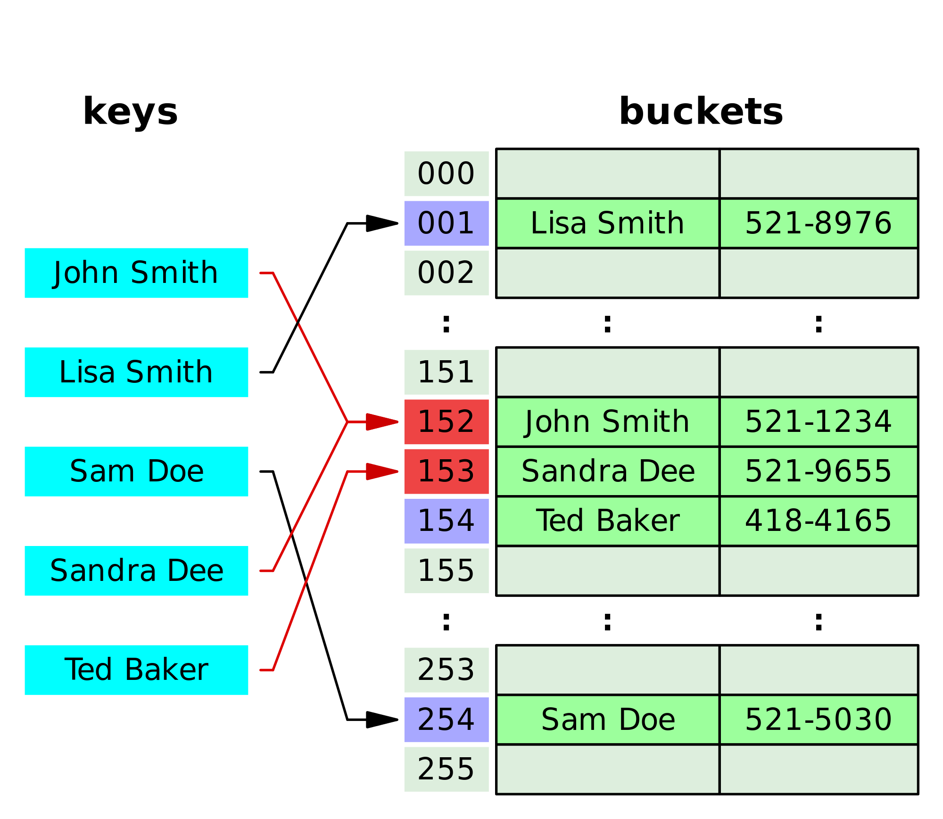
How hash maps are stored in the memory
Reference data type
Variable “phonebook” holds hash indexes that point to keys in the heap as values.
Each key points to a value in the memory.

Slide 24
HashMap<K, V> – Examples
Counting words occurrences in a list:
String[] words = { "yes", "hi", "hello", "hi", "welcome",
"yes", "yes", "welcome", "hi", "yes", "hello", "yes" };
Map<String, Integer> wordsCount = new HashMap<String, Integer>();
for (String word : words) {
Integer count = wordsCount.get(word);
if (count == null) {
count = 0;
}
wordsCount.put(word, count+1);
}
System.out.println(wordsCount); // {hi=3, yes=5, hello=2, welcome=2}

Slide 25
TreeMap<K, V> – Examples
Students and their grades
HashMap<String, ArrayList<Integer>> grades = new HashMap<>();
grades.put("Peter", new ArrayList<>(Arrays.asList(5)));
grades.put("George", new ArrayList<>(Arrays.asList(5, 5, 6)));
grades.put("Maria", new ArrayList<>(Arrays.asList(5, 4, 4)));
grades.get("Peter").add(6);
grades.get("George").add(6);
for (String key : grades.keySet()) {
System.out.println("" + key + " -> " + grades.get(key));
}

Slide 26
Future References
Java Oracle documentation - http://docs.oracle.com/javase/tutorial/collections/index.html
The book “Java Generics and Collections” - http://www.amazon.com/dp/0596527756/

Slide 27
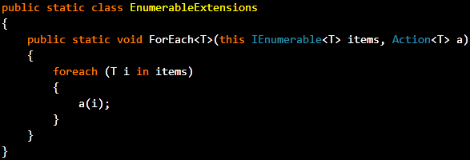
Collection Querying and Traversing
Iterative Approach

Slide 28
Collection Querying and Traversing
Native traversing can be done only on collections implementing the Iterable<T> interface
Set, Vector, List, Queue and AbstractCollection
List<String> names = new ArrayList<>(); for (String name : names) { System.out.println(name); }

Slide 29
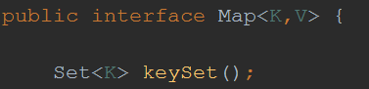
Collection Querying and Traversing (1)
Traversing cannot be done upon a Map<K,V> instance
The <K> type in a Map instance is always unique (a map cannot have duplicated keys)
This allows to traverse the keys through a collection that does not allow duplicates (Set)
Method keySet() from the Map<K,V> interface returns a Set

Slide 30
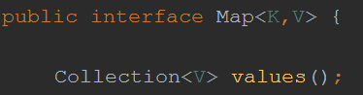
Collection Querying and Traversing (2)
The <V> type in a Map instance allows duplicates.
This allows to traverse the keys through an abstract collection (Collection)
Method values() from the Map<K,V> interface returns an abstract collection

Slide 31
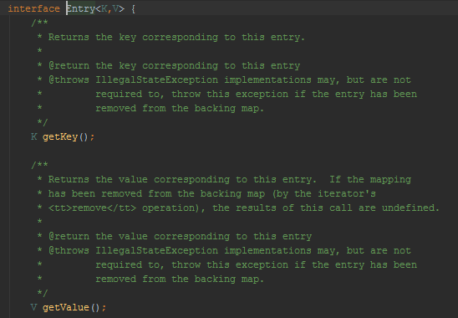
Collection Querying and Traversing (3)
To traverse the Key and Value pair, Java exposes a special interface called Entry<K,V> similar to C#’s KeyValuePair<TKey, TValue>

Slide 32
Collection Querying and Traversing (4)
The pair K,V is always unique, because of the uniqueness of the keyset.
Thus the collection that holds Key-Value pair does not allow duplicates (Set)
To retrieve a collection of Key-Value pairs, the Map interface exposes a method entrySet() which holds a Set of Entry instances

Slide 33
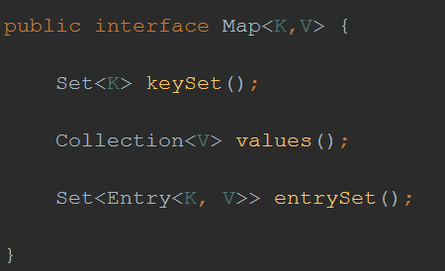
Collection Querying and Traversing (5)

Slide 34
Collection Querying and Traversing (6)
To query a collection one needs to iterate over it and find the desired result.
List<String> names = new ArrayList<>(); names.add("gosho"); names.add("pesho"); String desiredName = null; for (String name : names) { if (name.equals("pesho") { desiredName = name; break; } }

Slide 35
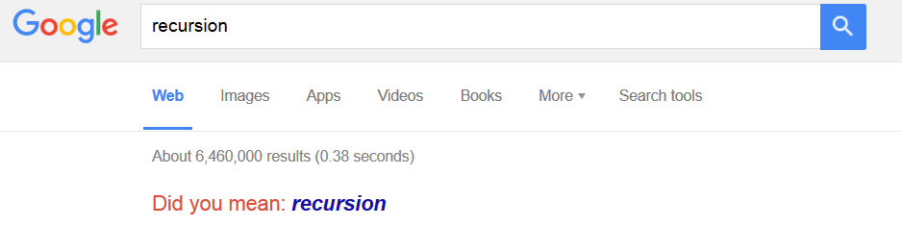
Recursion
Recursion

Slide 36

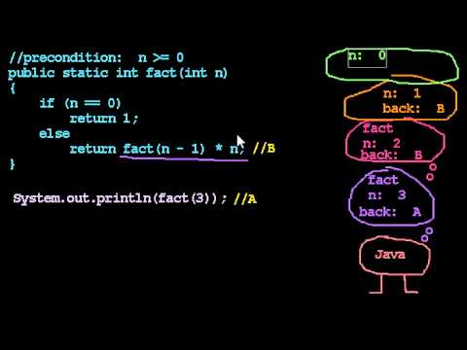
Recursion
In order to understand recursion one first has to understand recursion
Recursion is the process of repeating items in self-similar way
Method calling itself until bottom is reached
Recursion uses the system stack

Slide 37
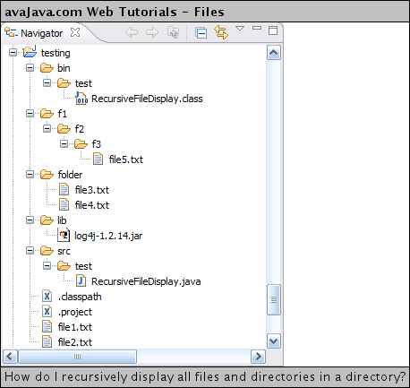
Recursion (1)
Recursion is highly used in traversal algorithms

Slide 38
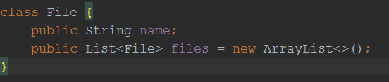
Recursion (2)
Traversing file system
Each object of type File is a file unless List<File> is populated
Then it’s folder
This folder can have child folders with files too

Slide 39
Recursion (3)
public static void main(String[] args) { File diskC = new File(); diskC.name = "Hard Drive (C)"; File autoexec = new File(); autoexec.name = "autoexec.bat"; // just a file diskC.files.add(autoexec); // autoexec.bat is now child of disk C File errorLog = new File(); errorLog.name = "errors.log"; // just a file diskC.files.add(errorLog); // error.log is now child of disk C }

Slide 40
Recursion (4)
It’s easy to retrieve Disk C’s children
But what if one of the files is a folder?
for (File f : diskC.files) { System.out.println(f.name); }
File windows = new File(); windows.name = "Windows"; File system32 = new File(); system32.name = "System 32"; windows.files.add(system32); // windows is a folder now diskC.files.add(windows); // windows folder is child of disk C

Slide 41
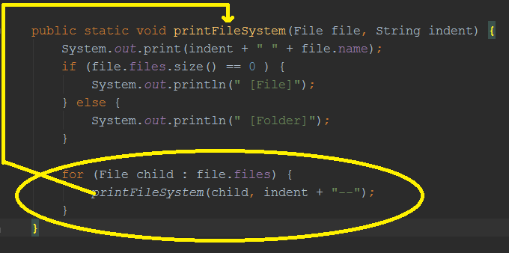
Recursion (5)
The foreach has to be called upon each child

Slide 42
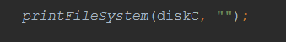
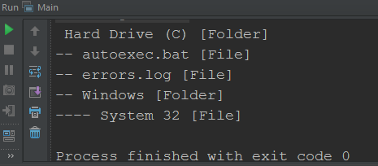
Recursion (6)
Starting from Disk C until reaching the last file
Output:

Slide 43

Summary
Arrays, Strings and Collections:
Arrays: int[], String[], etc.
Lists: ArrayList<E>
Sets: HashSet<E>, TreeSet<E>
Maps: HashMap<K, V>, TreeMap<K, V>

Slide 44








Java Collections
https://softuni.bg/courses/java-basics

Slide 45
License
This course (slides, examples, demos, videos, homework, etc.) is licensed under the "Creative Commons Attribution-NonCommercial-ShareAlike 4.0 International" license
Attribution: this work may contain portions from
"Fundamentals of Computer Programming with Java" book by Svetlin Nakov & Co. under CC-BY-SA license
"C# Basics" course by Software University under CC-BY-NC-SA license

Slide 46






Free Trainings @ Software University
Software University Foundation – softuni.org
Software University – High-Quality Education, Profession and Job for Software Developers
softuni.bg
Software University @ Facebook
facebook.com/SoftwareUniversity
Software University @ YouTube
youtube.com/SoftwareUniversity
Software University Forums – forum.softuni.bg

